Slide 1
Session 3: Competing in Concentrated Markets Microsoft vs. Google, Shrimp
Competitive Strategy
Luis Garicano

Slide 2
Outline
Concentrated markets and game theory
What is game theory?
How will we use it?
Rivalry game -- The problem: Too much competition
Even though it destroys profits!!
The solution: repetition
Notes:
Game theory makes prediction about behavior. We will reach these predictions by assuming full rationality. You may wonder whether people are really so rational. (Similarly, in the demand and supply experiment you it is clear that people do not really compute demands and supplies.)
The point, again, is that the concept of equilibrium under perfect rationality is a pretty good tool to understand aggregate behavior. People may not solve complex optimization problems but use heuristics that they update every so often. In addition, more successful agents are selected by markets (survivor explanation). Concept of “as if” rational. Give story of the spider webs in the desert. The rationality assumption should be taken metaphorically rather than literally. Metaphorical in the sense that it capture some features that are qualitatively important.
What determines price competition in an industry?
Why are some firms able to coordinate their pricing behavior and make large profits while other firms engage in vicious price wars?

Slide 3
Oligopoly and Game Theory
Extreme market structures:
Monopoly: no rivals
Perfect competition => No need to consider rivals’ reactions
Intermediate case:
Oligopoly (Greek=few sellers) or concentrated industry=> Need to consider rivals’ reactions
Game Theory:
formal study of strategic behavior, relation between inter-dependent agents (firms, trade authorities, armies, litigation…)
Notes:
Game theory makes prediction about behavior. We will reach these predictions by assuming full rationality. You may wonder whether people are really so rational. (Similarly, in the demand and supply experiment you it is clear that people do not really compute demands and supplies.)
The point, again, is that the concept of equilibrium under perfect rationality is a pretty good tool to understand aggregate behavior. People may not solve complex optimization problems but use heuristics that they update every so often. In addition, more successful agents are selected by markets (survivor explanation). Concept of “as if” rational. Give story of the spider webs in the desert. The rationality assumption should be taken metaphorically rather than literally. Metaphorical in the sense that it capture some features that are qualitatively important.
What determines price competition in an industry?
Why are some firms able to coordinate their pricing behavior and make large profits while other firms engage in vicious price wars?

Slide 4
Game Theory
Began in 1944 by von Neumann and Morgenstern.
Key development: in conventional economics market structure given.
People and firms are like machines, optimize given prices.
With few players, need to consider interdependencies.
Value created by combinations of players

Slide 5
What is Game Theory?
Key problem in Shrimp: anticipate rival’s action
How will they choose
How will they react to my decisions
Game theory: formal analysis of strategic interactions
Applicability:
not set up model and solve;
rather, get insight
into the strategic interaction
into effect of changing the game

Slide 6
Outline
Concentrated markets and game theory
What is game theory?
How will we use it?
Rivalry game -- The problem: Too much competition
Even though it destroys profits!!
The solution: repetition
Notes:
Game theory makes prediction about behavior. We will reach these predictions by assuming full rationality. You may wonder whether people are really so rational. (Similarly, in the demand and supply experiment you it is clear that people do not really compute demands and supplies.)
The point, again, is that the concept of equilibrium under perfect rationality is a pretty good tool to understand aggregate behavior. People may not solve complex optimization problems but use heuristics that they update every so often. In addition, more successful agents are selected by markets (survivor explanation). Concept of “as if” rational. Give story of the spider webs in the desert. The rationality assumption should be taken metaphorically rather than literally. Metaphorical in the sense that it capture some features that are qualitatively important.
What determines price competition in an industry?
Why are some firms able to coordinate their pricing behavior and make large profits while other firms engage in vicious price wars?

Slide 7
Rivalry game example: Fashion Pricing
Use real stores, prices and quantities, and consider asymmetric payoffs
You are managing a line of fashion garment.
End of the season
Must discount to liquidate stock.
Decision: start discounting now or wait.
Only one competitor who is in the same situation as you.
fashion sensitive customers buy only the items they like
Estimate: 2m additional profits from fashion customers if you keep prices high only 1m if you discount now.
bargain hunters buy any discounted item.
4m profits from the bargain hunters if you discount now and your competitor waits,
2m if you and your competitor discount at the same time,
nothing from them if you wait and your competitor discounts now.
Notes:
How to approach a game:
1-i f you have a dominant strategy, use it
2-if there is a dominated strategy ignore it
Sometimes games can be solved by just looking at dominant and dominated strategies. However, other times this is not possible. Then, use the Nash equilibrium concept.

Slide 8
The Fashion Pricing Game Formal Approach
(Numbers in the table are profits)

Slide 9
Game: A Model of Strategic Interactions
What is a game?
Players (e.g. Store 1 and Store 2)
Rules (e.g. simultaneously
choose whether to start
discounting)
Strategies (Discount or wait)
Payoffs (Profits from strategy)
Note: Numbers in the table are firm profits
Notes:
The payoffs here correspond to profits.
For now, we look at simultaneous games. Later, we will also consider sequential games. Simultaneity is reasonable as long as players do not know what other players are doing when they make their decisions. Imagine “as if” simultaneous.
Equilibrium is a concept of a rest point. Exactly like demand and supply model. (e.g. mechanical models in physics)
Recognize situations with strategic dimensions. Break down the strategic dimension into players, strategies and payoffs. Keep in mind that what others do matters. All players take into account everybody else’s actions. “scenario building”.
Models of non-cooperative behavior. No enforceable contracts can be written. We ignore bilateral deviations.
Use the game description to capture the key features of the interaction. Then, you can more easily determine what is a good strategy, and figure out what your rival is likely to do.

Slide 10

Equilibrium Concept of Reasonable Outcome
Nash Equilibrium= concept of “reasonable” outcome
http://www.nobel.se/economics/laureates/1994/index.html
Definition: Given what other players are doing, no player would want to change strategy unilaterally (i.e. each player’s strategy is an optimal response to the other players’ strategies)

Slide 11
Two key Concepts in Game Theory
Nash Equilibrium
Each player is doing best than he/she can, given the strategies of other players
Does not maximize joint profits!
Requires that reactions be mutually consistent
Dominant Strategy
Player’s strategy is best no matter what the others choose

Slide 12
So what is the pricing problem?
Players have a dominant strategy – they should reduce prices
if you do not reduce– I am better off undercutting you and stealing market share
if you do – I am better of matching you
Regardless, we are likely to end up fighting even though it is in nobody’s interest.

Slide 13
Another example: Airbus and Boeing
Other Examples
Choice of quantities by OPEC members
Price setting at neighboring petrol stations
Fare wars in airline industry
Notes:
Provide the complete monopoly maximization story with explicit demand.

Slide 14
Pricing like a prisoner’s dilemma (players a and b)

Slide 15
Two types of rivalry games: Capacity versus Price Competition
Shrimp is an example of a capacity (not price) choice game (this is technically called a Cournot game)
Similar Logic: you end up producing too much, even though that only benefits consumers.
Objective: find quantity that maximizes my profits given what I think my rivals are doing

Slide 16
Nash Equilibrium in Shrimp Game
At Nash Equilibrium, no firm has an incentive to revise its choice of quantity
At any other point, it pays for at least one of the rivals to revise the quantity
Nash Equilibrium in shrimp (see handout):
q_{a} = q_{b} = q_{c} =50
Important: profits are less than monopoly; individual profit maximization does not imply joint profit maximization

Slide 17
Price Competition (Bertrand Game– we did in first class)
Firms compete on prices
Assume all goods and consumers identical-- then undercutting by a little bit rival’s price means stealing all the demand
Then only Nash Equilibrium is MC=P even with only two rivals
more extreme outcome than with capacity choices: note that NO PROFITS!!
If goods differentiated, cannot steal all demand, but similar game logic

Slide 18
Is the Nash equilibrium THE solution of one off game?
Profits per firm in shrimp Nash=500. In our Game some worlds do better sometimes or almost every time
Why was sometimes better
Ability to coordinate (more later)
Why worse?
Did not try to anticipate behavior of others?
Try to beat others, rather than max. profits
Inability to coordinate

Slide 19
Pricing Game as a Prisoner's dilemma
Crucial problem in Shrimp game (and all oligopoly pricing situations): at quantity that produces highest profits for all each rival has incentive to increase production
That’s why monopoly quantity (Q=33) not a NE
But if could coordinate all rivals better off
In most shrimp games, lowest profit in most profitable world was better than highest profit in least profitable world

Slide 20
Outline
Concentrated markets and game theory
What is game theory?
How will we use it?
Rivalry game -- The problem: Too much competition
Even though it destroys profits!!
The solution: repetition
Notes:
Game theory makes prediction about behavior. We will reach these predictions by assuming full rationality. You may wonder whether people are really so rational. (Similarly, in the demand and supply experiment you it is clear that people do not really compute demands and supplies.)
The point, again, is that the concept of equilibrium under perfect rationality is a pretty good tool to understand aggregate behavior. People may not solve complex optimization problems but use heuristics that they update every so often. In addition, more successful agents are selected by markets (survivor explanation). Concept of “as if” rational. Give story of the spider webs in the desert. The rationality assumption should be taken metaphorically rather than literally. Metaphorical in the sense that it capture some features that are qualitatively important.
What determines price competition in an industry?
Why are some firms able to coordinate their pricing behavior and make large profits while other firms engage in vicious price wars?

Slide 21
Solution: Coordination and Dynamic pricing
The point then is to manage to coordinate intention for low quantity
If there is a long horizon of interactions in front, then it is possible to coordinate
In our game, last round completely uncooperative, even round before last
Why?: key role of expectation of punishment

Slide 22
Punishment and coordination
With repetition, coordination possible
If don’t cheat, can charge monopoly price for ever, and get half of monopoly profit
If cheat, engage in price war, and get in low profit equilibrium for ever
Note crucial role here of long horizon
Example: airlines that are on the verge of bankruptcy cut prices. Why? Future not valuable to them (they won’t be around)

Slide 23
Repeated Play can sustain cooperation
As long as the gain from deviation and not being able to cooperate in the future (the loss if punish and cannot cooperate) is smaller than the gain from cooperation
Can facilitate cooperation by making the deviation
Yield a small gain
Easy to detect
Incur in a heavy but credible punishment
Small relative to the future (e.g. value future a lot, there is growth so that future is worth a lot relative to the present, things are quite certain)

Slide 24
Repeated Play
profits
Defect
Cooperate
Punish
t
=> Worry about future cooperation keeps you ‘honest’

Slide 25
Repeated Play: Deviation Attractive
profits
Defect
Cooperate
Punish
t
Here you do not really have much to lose in terms of
future cooperation so more likely to “cheat”

Slide 26
Repeated Play: Deviating Unattractive
profits
Defect
Cooperate
Punish
t
=> Worry about future cooperation keeps you ‘honest’

Slide 27
How do you promote implicit coordination?
Axelrod: tit-for-tat is (experimentally) best strategy to induce cooperation
Do what your rival did to you previously
Examples:
Clause that ‘we will not be undersold’
Airline industry in 1998 (see next slide)

Slide 29
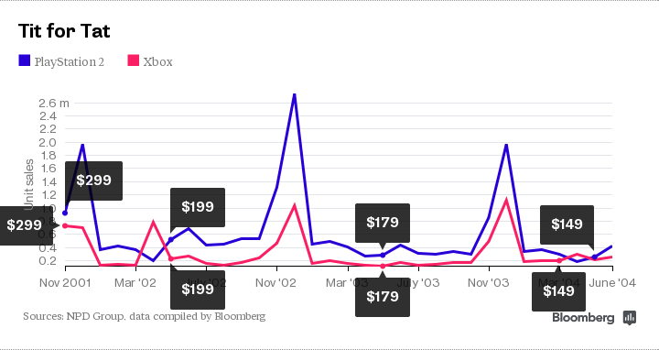
Console Wars

Slide 30
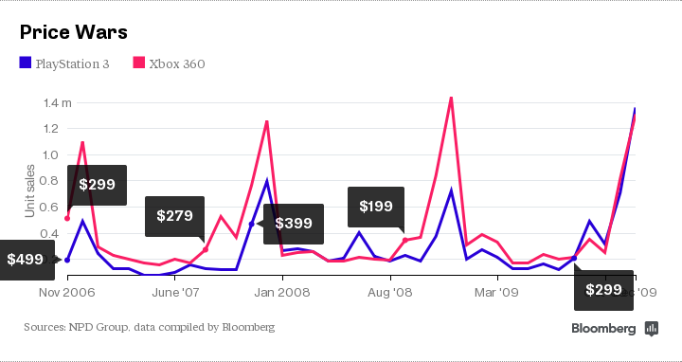
Console Wars 2:

Slide 31
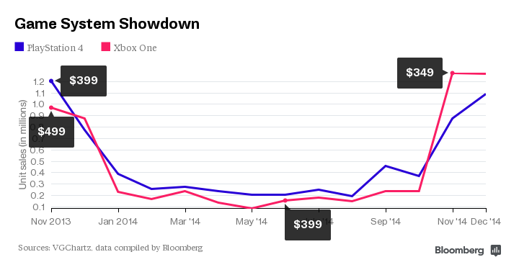
Console Wars (3):No Differentiation (Sales)

Slide 32
Tit-for-tat
Why does it work? Axelrod argues:
Punishes firm that does not cooperate but does not punish for ever
Easy for rival to understand
Never defects first, in order not to provoke retaliation
Problem: large cost of slight misperception
Any mistake ‘echoes’ back and forth
A solution (DN:113): forgiving tit-for-tat
Wait until it is clear that defection taking place

Slide 33
Industry structure conditions that facilitate implicit cooperation
A small number of firms in market
Large firms are unequally sized
Public price or other sale conditions
Firms are otherwise (culturally, technologically) similar
Asset Specificity is low
High capacity utilization
Demand and costs are stable

Slide 34
Facilitating Practices
Firms can undertake practices that facilitate implicit cooperation
See book
Price leadership
Advance announcement of price changes
Most favored customer clauses
Meet the competition clause
Strategic use of inventories and backlogs
Buffering to avoid gaining market share when demand goes down

Slide 35
Firm Asymmetries and Price Umbrellas
If small firm undercuts large firm, large firm may decide not to respond (Airlines)
Matching is very costly (large number of units sold times the decrease in the margin)
Gain from matching is small (since rival is small)

Slide 36
Focal Points
Problem with tacit cooperation: many long run equilibrium points. How to choose one in particular?
Use a focal point: a point that industry consider reasonable
Example: Department stores mark-up of 200%.
OPEC: maintain certain historical market shares
Criteria for choosing focal points: history, symmetry, efficiency...

Slide 37
Example: Airline industry
Airlines: industry analysis:
Demand volatile
Very high fixed cost, low marginal cost
Low BTE
No differentiation
Very hard to coordinate: multiple fares/non-transparent pricing
Result: brutal price competition

Slide 38
Changing the Game: American Airlines Value Pricing
American Airlines introduced value pricing in April 1992 which simplifies tariffs
All fares built by distance x 4 fares
This gives up price discrimination possibility- what is the point?

Slide 39
Changing the Game: American Airlines Value Pricing
American airlines introduced value pricing in April 1992 which simplifies tariffs
All fares built by distance x 4 fares
This gives up price discrimination possibility- what is the point?
Under old system, 93% of fares discounted
In effect, raises fare
But do not need to abandon price discrimination?

Slide 40
Why do it?
Simplify
Facilitate price coordination
If all follow everyone better off

Slide 41
But
Northwest Airlines announcement (May 1992)
“KIDS FLY FREE”

Slide 42
Response?
Tit for tat?
Kinds fly free too?
NO!: GO NUCLEAR
50 % price cut on every seat every fare every flight

Slide 43
Why NWA did this?
Target elastic segment
Great if rivals do not respond
Asymmetries mean this works even if rivals respond
NWA was worst airline/lowest quality
If rivals are capacity constrained, NWA gains disproportionately from lower prices
In general, worse players gain from extra demand coming in at lower prices
Price wars tend to get started by smaller/worse players

Slide 44
Take Aways
Concentrated markets and game theory
Oligopolistic markets different from perfect competition
Need to predict what your rival will do
Game theory is a tool to do this
Rivalry game –
Like a prisoner’s dilemma
The problem: more competition than either of players would like
The solution: repetition
Dynamic strategies that are clear, imitable, and reduce incentive to deviate while increasing punishment

